Slide 1


Slide 2

Setup free teacher account
Navigate to education.weebly.com
www.p3edtech.com

Slide 3
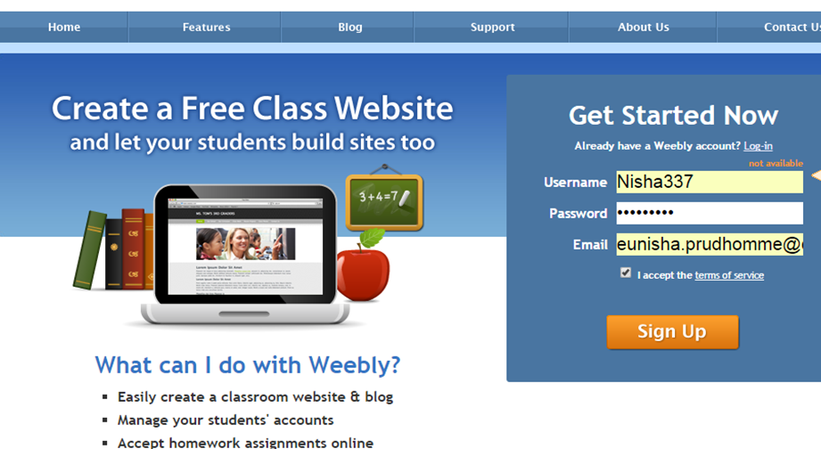
Choose username and password
C
www.p3edtech.com

Slide 4
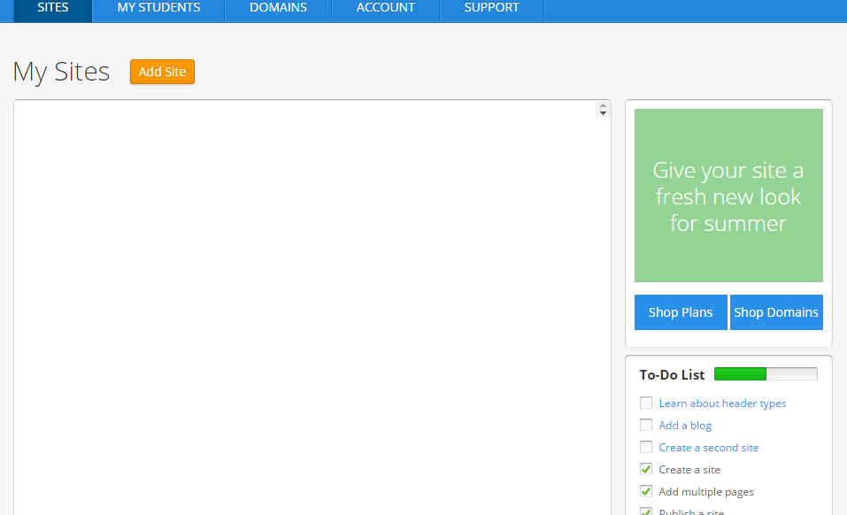
Add Site
Click to Add Site
www.p3edtech.com

Slide 5
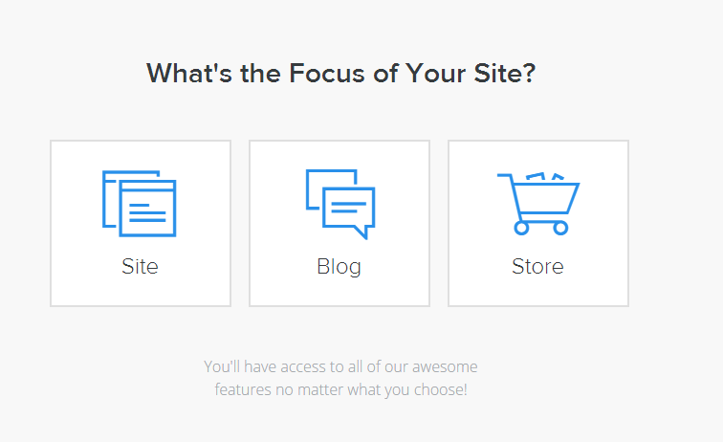
Choose “blog”
Choose Blog
www.p3edtech.com

Slide 6
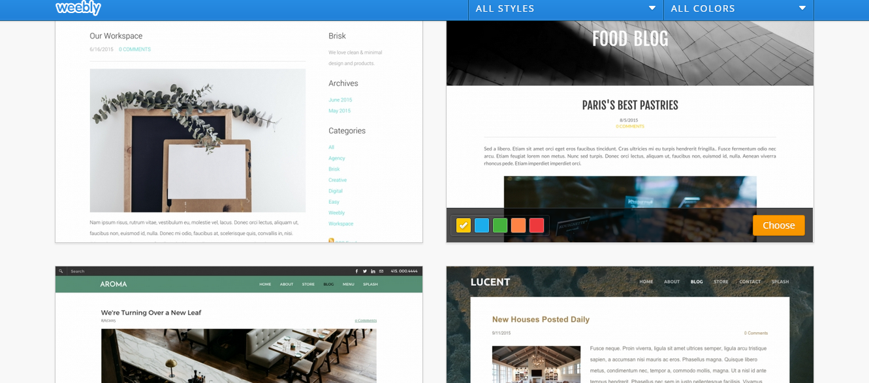
Choose theme
Select theme and click on “Choose”
www.p3edtech.com

Slide 7
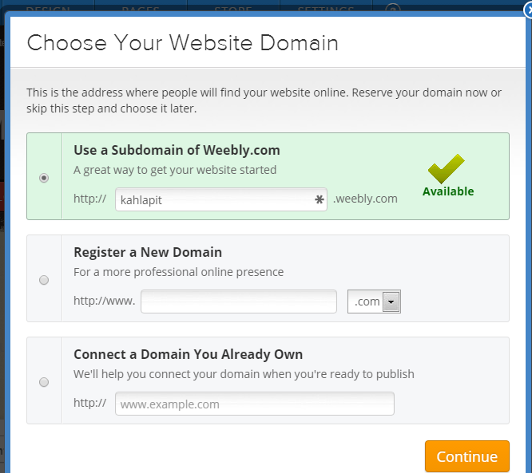
Choose a domain
Choose Subdomain of Weebly (free), type in site name, click on Continue
www.p3edtech.com

Slide 8
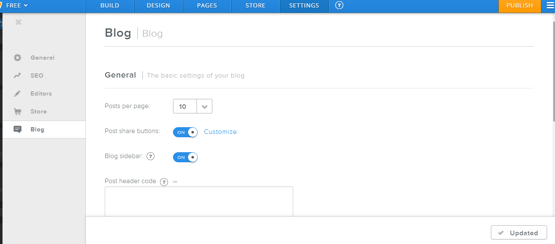
Customize blog settings
Customize settings based on your preferences and click on Publish
www.p3edtech.com

Slide 9
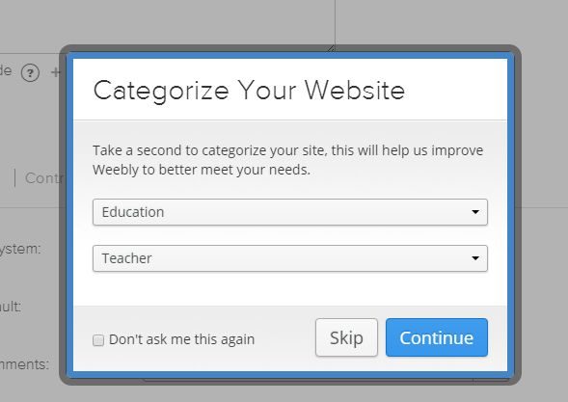
Choose site category
Choose Site Category, then click Continue
www.p3edtech.com

Slide 10
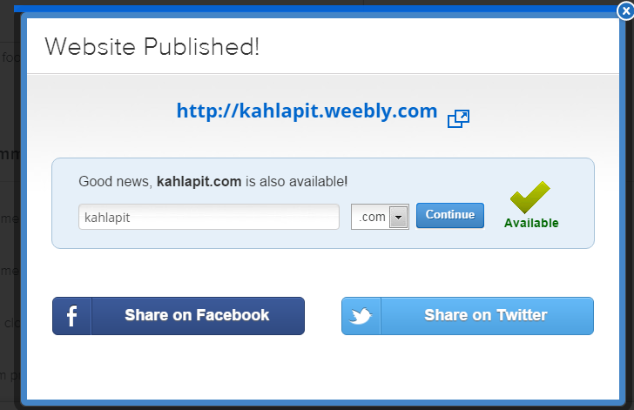
Setup Complete
Setup complete! This is your site name. Your blog name is the same name followed by “/blog”. Click the “x”
www.p3edtech.com

Slide 11
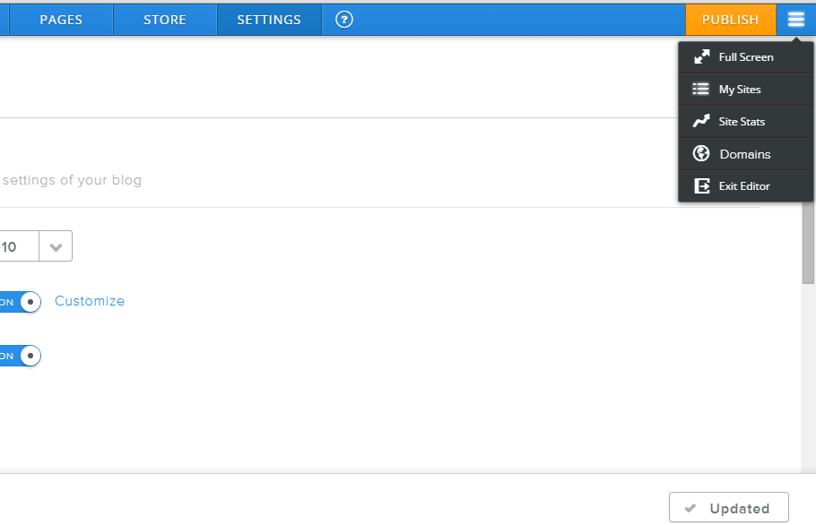
Edit Blog page
Click the menu button and choose “My Sites”
www.p3edtech.com

Slide 12
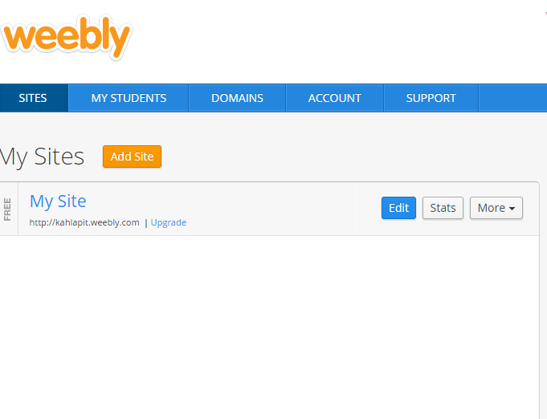
Edit blog
Choose “Edit”
www.p3edtech.com

Slide 13
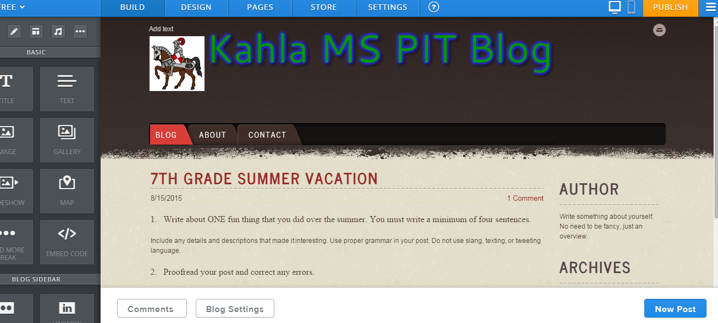
Add new post
Click on “New Post”
www.p3edtech.com

Slide 14
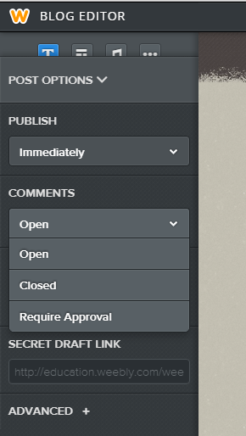
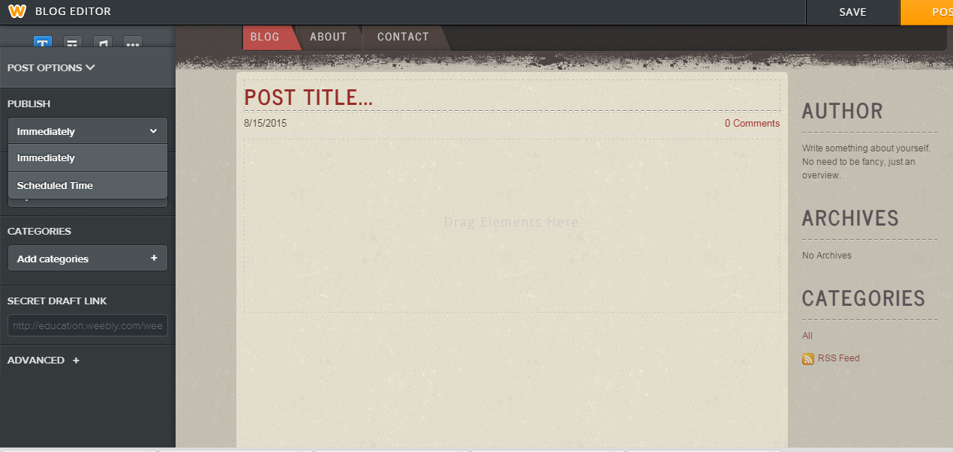
Set post options
Set Post Options based on your preferences, then choose Save
www.p3edtech.com

Slide 15
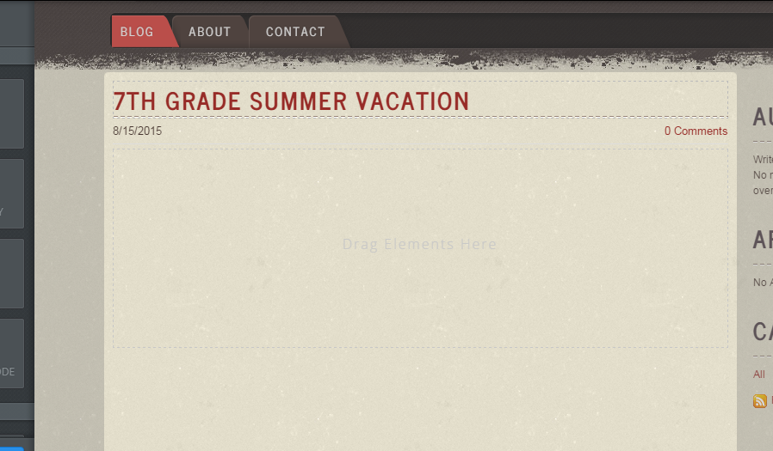
Type in post title
Click in title box and give your post a title
www.p3edtech.com

Slide 16
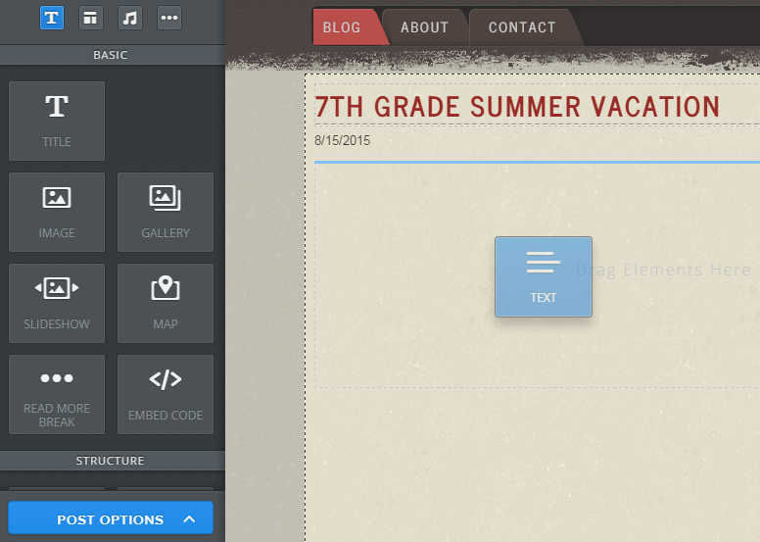
Add a text block
Drag a text block from the “basic” tools, and drop it in post area
www.p3edtech.com

Slide 17
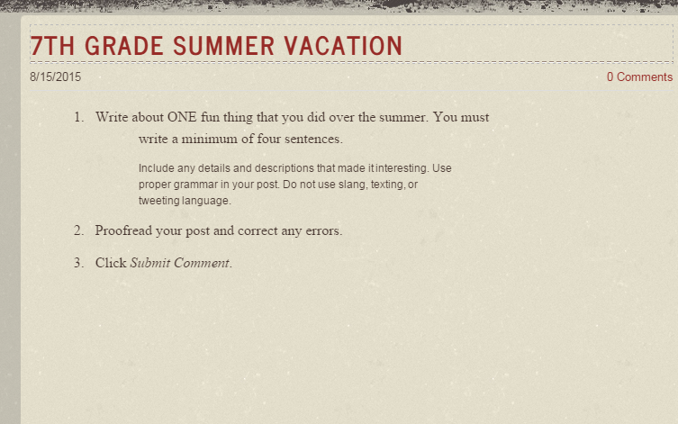
Type your post inside of text block
Type your post inside of the text block, then click save
www.p3edtech.com

Slide 18
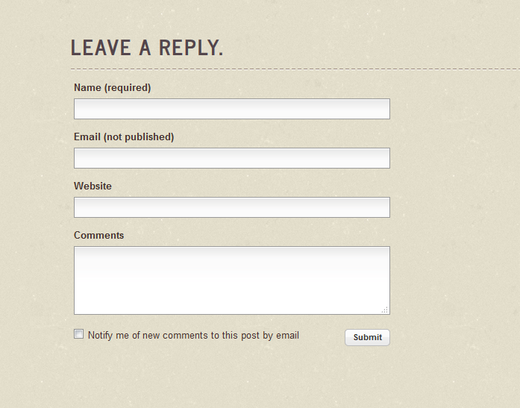
Reply box
Students may submit reply via Reply box, first name and last initial only (for safety reasons)
www.p3edtech.com

Slide 19
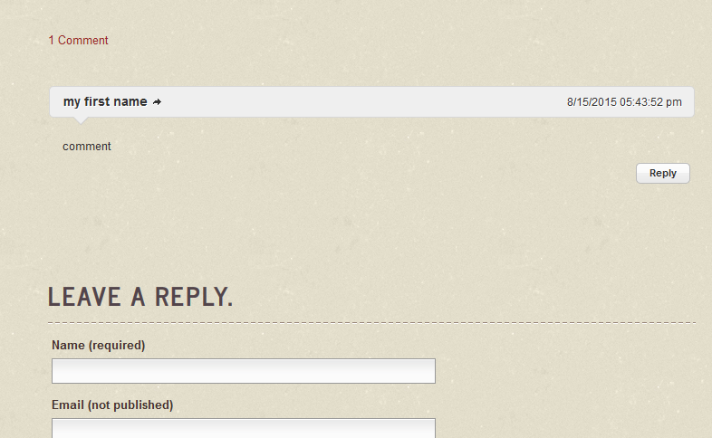
Reply to a comment
Students can reply to the comments of others.
www.p3edtech.com

Slide 20
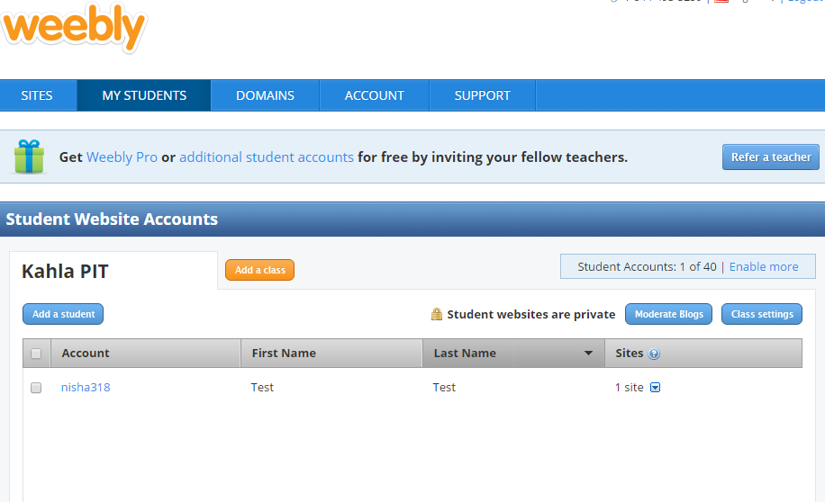
Student accounts
You may add student accounts to the teacher account, but you only get 40 free per teacher e-mail address. Each add’l costs $1 per student ☹ http://students.weebly.com/
www.p3edtech.com

